Slide 1

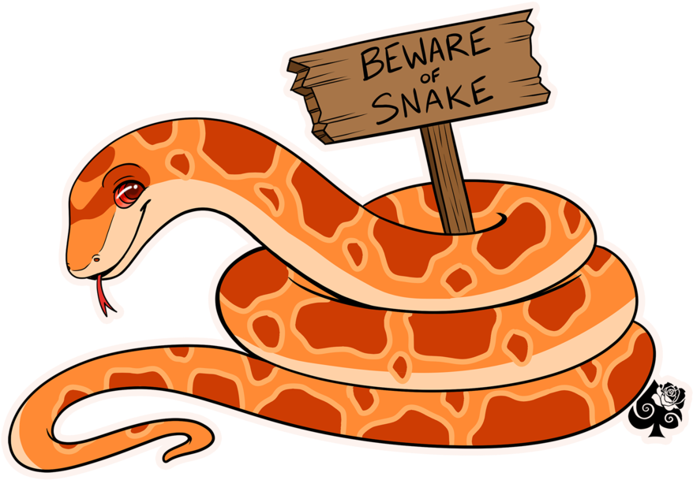
Introduction to R – 3
Data Exploration + visualisation

Slide 2
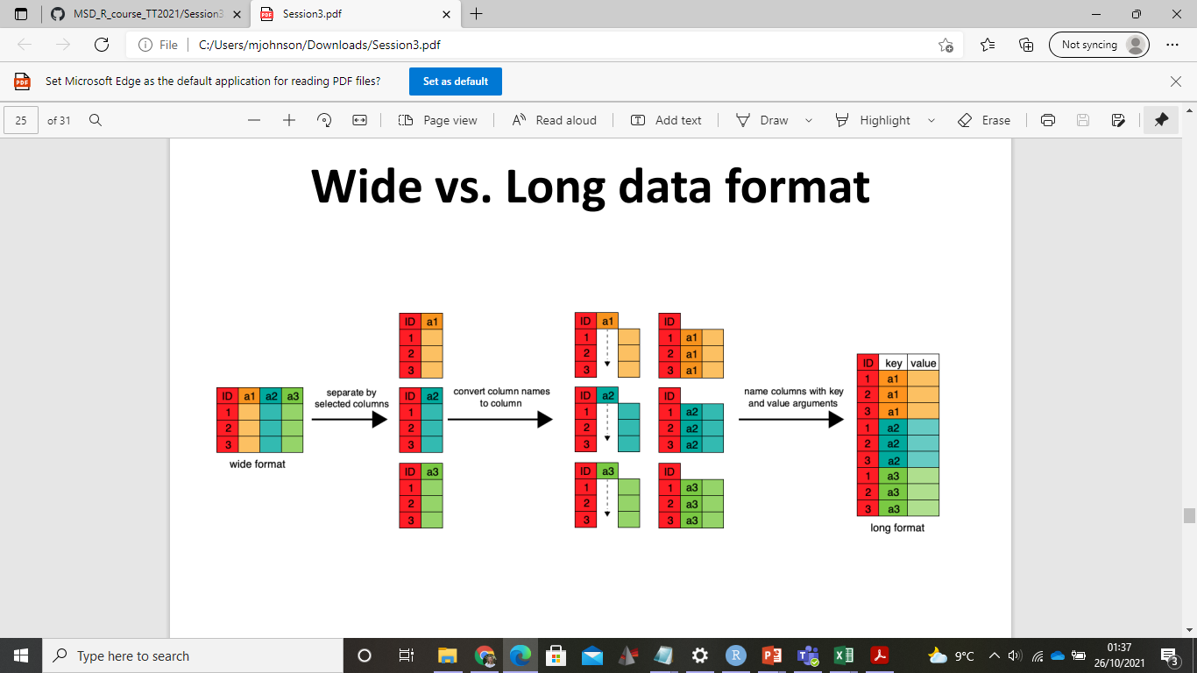
Recap
Setting up your data for R from Excel
Transforming data from wide to long format
Long format: each obvs of a sample or participant is a separate row
Summary statistics
Calculate basic stats such as mean or sum
Save stats as a separate vector, or append to dataframe as a new column using mutate
Data manipulation using dplyr functions: group_by(), filter(), mutate()
mutate
Notes:
Number of ways you can approach this, can transform in Excel, or use gather function

Slide 3
Today’s objectives
Set up flow cytometry dataset for analysis in R
Produce some pretty plots using GGPLOT
Dataset is from an experiment measuring the amount of antibody dependent phagocytosis following typhoid vaccination in Nepal https://doi.org/10.3389/fitd.2021.742804

Slide 4
Let’s explore in R
Data set up

Slide 5
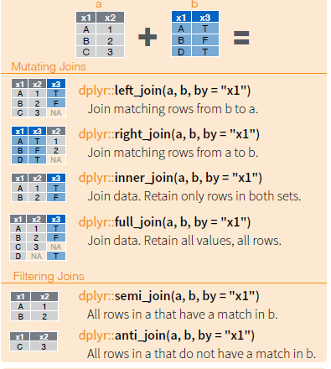
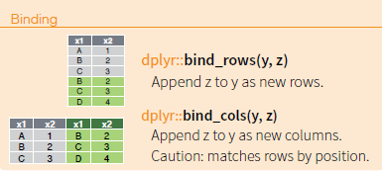
Joining data frames
left_join(dataframe_a, extradata_b, by = c(“Joining variables”))
Can use a matching join, filtering join or a simple bind
Steps:
1) Figure out what you variable you are going to join data frames by e.g ID
2) What data set is being merged into which?
3)What sort of join would you like to perform?
Notes:
One of the most useful functions!
don’t recommend binding typically in case there is a mismatch in labels or your order, left join will sort it out for you,
ID very common joining variable
I still frequently refer back to the cheat sheet when joining data frames,

Slide 6
Let’s explore in R
Joining

Slide 7
GGPLOT - Syntax
http://www.sthda.com/english/wiki/ggplot2-essentials (good guide!)
For plotting data we will use the ggplot2 package
ggplot is our plotting function; tells R to plot what we define in the rest of the code
data is our data frame
Aes is used to indicate aesthetics x and y variables. It can also be used to control the colour, the size or the shape of points, etc…..
Geom_ defines the type of graph we want to plot (box plot, dot plot, ...)
Extra layers such as geom_, labels, scales, themes are added to the main plot code by using + sign
ggplot(dataframe, aes(x =visit, y=mean_phago) + geom_boxplot()
Notes:
Now that our data is in good shape and all the variables are computed, we’re ready to try some plotting ☺
base r uses plot() function
Aesthetics is how you ‘map’ your data to the plotting space, so what are you going to use as x and y, what extra variable are you going to use to colour your graph by

Slide 8
Let’s explore in R
Plotting

Slide 9
GGPLOT - Customisation
Many ways to add colours; colour plot by a factor in your data frame:
ggplot(dataframe, aes(x= visit, y= mean_phago, fill = Variable to colour data by)) + geom_boxplot()
To add labels, add +labs() layer to your plot
+ labs(x = "New x axis label", y = “ ", title =“ ", subtitle = “ ",caption = “ ")
Notes:
This is where it’s important to have recoded as factor, if variable was character ggplot would not be able to split the data up correctly
Default ways but I prefer the scales package

Slide 10
Let’s explore in R
Customisation

Slide 11
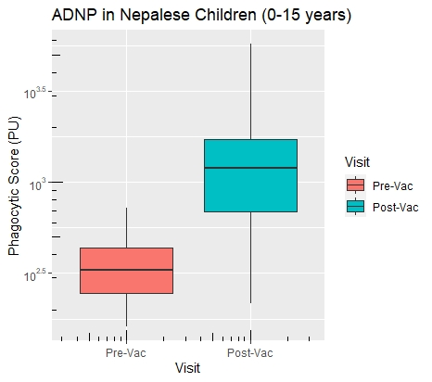
Axis Customisation
To change axis scales: load scales package
+ yscale("log10", “log2” .format = TRUE)
Add axis ticks using + annotation_logticks()
To modify axis limits use: +ylim() + xlim()
Notes:
Format option decides if we want to code files

Slide 12
Let’s explore in R
Customisation - scales

Slide 13
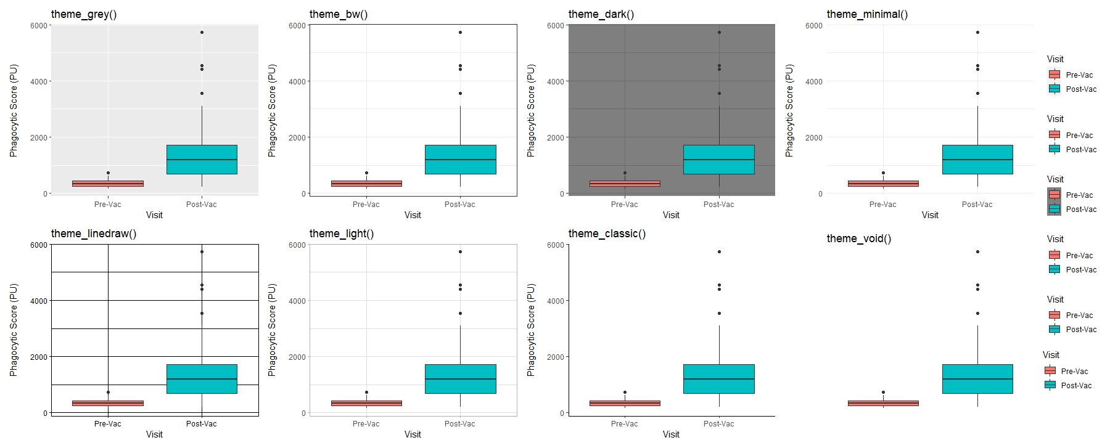
Themes
Provide quick and easy ways to clean your plot appearance
You can also create custom themes, removing legends, axis, text size, setting background colours etc.
Notes:
Highly recommend setting a theme once you’re happy with a plot’s appearance, and using it to keep graphs consistent

Slide 14
Let’s explore in R
Themes

Slide 15
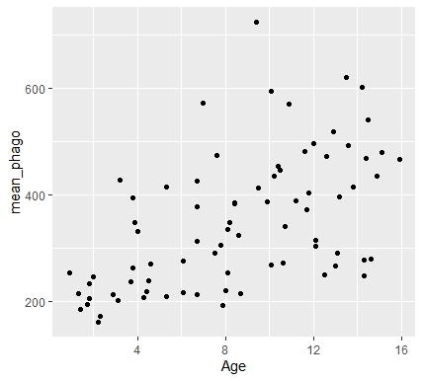
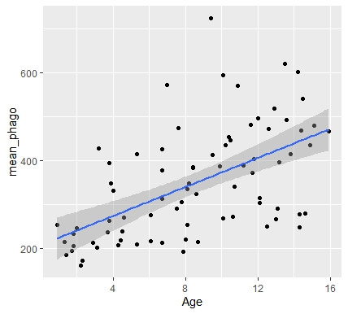
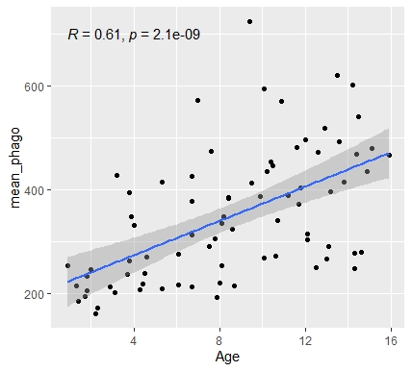
Correlation Plots
ggplot(dataframe, aes(x= Age, y= mean_phago)) + geom_point() + geom_smooth() + stat_cor(method = "pearson")
Plot a scatter graph of data using + geom_point()
Fit a regression line to our data using + geom_smooth(method = lm)
Add regression stats using + stat_cor(method = "pearson") – from ggpubr package
)
Notes:
Method=lm, SE around mean,
More details at :http://www.sthda.com/english/wiki/ggplot2-scatter-plots-quick-start-guide-r-software-and-data-visualization

Slide 16
Let’s explore in R
Correlation Plots

Slide 17
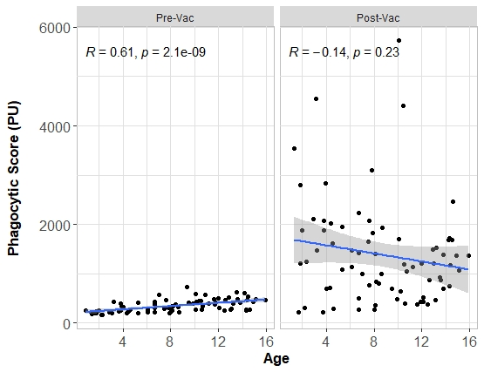
Faceting
Facet layer splits the plotting of your data by a factor variable
+facet_wrap(~Variable to split by)
+facet_wrap(Var1~Var2)
Notes:
Factor/categorical

Slide 18
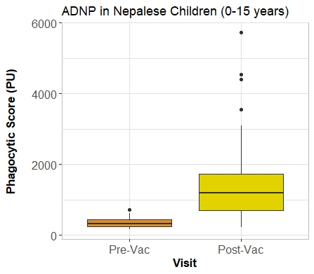
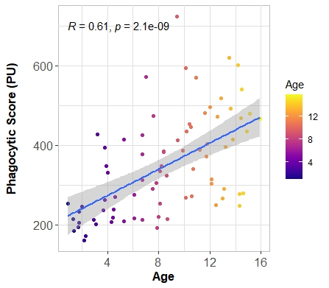
More Colours!
Colours can easily be added to plots from a variety of custom packages; Rcolorbrewer, viridis, wesanderson
+scale_fill_manual, +scale_fill_brewer + scale_fill_vidris
+scale_colour_manual, +scale_colour_brewer + scale_colour_viridis
+scale_color_gradient(), +scale_fill_gradient()
Notes:
Big plots need filling in to remember

Slide 19
More Colours!
R colours can include anything specified by hex code
Any colour choice is possible - colortools package
Consider the rules of colour theory when plotting your data
contrasting results use complimentary, or triadic colours
Variations of a result i.e repeat observations use similar shades/schemes
Consider colour blindness – especially if colour is being used as the primary way for distinguishing data
http://colorschemedesigner.com/csd-3.5/ colour blind simulator

Slide 20
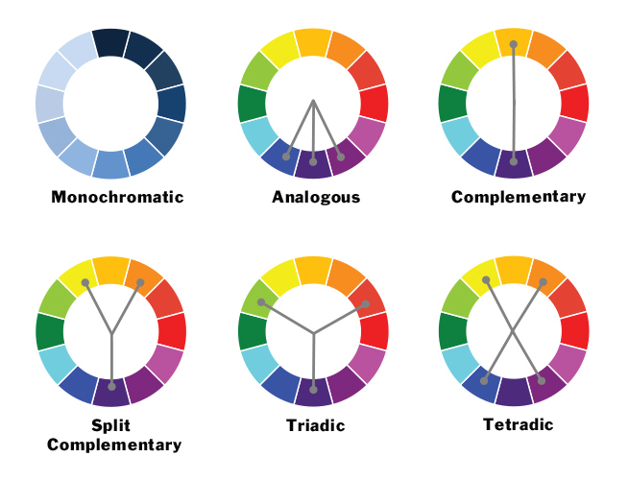
Colour theory
Monochromatic: Variations of the same colour.
Analogous: colours next to each other in wheel > narrow harmonious colour scheme.
Complementary: Colours from the opposite ends of the wheel > most contrast.
Split Complementary: A variation of the complementary, uses two colours on either side of a directly complementary colour > high visual contrast but less visual tension than pure complementary
Triadic: Three colours equally spaced around the colour wheel > vivid visual interest.
Tetradic: Two pairs of complementary colours > strong visual contrast while retaining harmony.
Notes:
Choice also depends on data you have, i.e number of plots
Probably save for end of next ggplot tutorial

Slide 21
Let’s explore in R
Colour design:
colortools package

